Slide 1


“The Value Networking Company”
September 2005

Slide 2


This presentation has been prepared by KT Corp. This presentation contains forward-looking statements, which are subject to risks, uncertainties, and assumptions. This presentation is being presented solely for your information and is subject to change without notice. No representation or warranty, expressed or implied, is made and no reliance should be placed on the accuracy, actuality, fairness, or completeness of the information presented. The Company, its affiliates or representatives accept no liability whatsoever for any losses arising from any information contained in the presentation.
This presentation does not constitute an offer or invitation to purchase or subscribe for any shares of the Company, and no part of this presentation shall form the Basis of or be relied upon in connection with any contract or commitment. Any decision to purchase shares of the Company should be made solely on the Basis of information, which has been publicly filed with the Securities and Exchange Commission or the Korea Stock Exchange and distributed to all investors.
The contents of this presentation may not be reproduced, redistributed or passed on, directly or indirectly, to any other person or published, in whole or in part, for any purpose.

Slide 3

Table of Contents
T
- Fixed-Voice
I. 2005 1H Financial Results
- Broadband
- PCS Resale
- Marketing Expenses
- Regulations
- Labor Expenses
II. 2005 2H Outlook - Revenue
III. 2005 2H Outlook – Operating Profit
IV. Shareholders Return

Slide 4








2005 1H Financial Results
2
Revenue
(KRW Trillion)
Operating Profit
(KRW Trillion)
6.06
Marketing expenses
5.97
0.10
0.34
0.25
0.15
FTC fine
0.15
Salary increase
1.33
0.95
5.72
5.72
2004 1H
2005 1H
2004 1H
2005 1H
Handset sales

Slide 5





Fixed-Voice
F
Successful Response to FNP
95.1%
93.4%
Revenue
(KRW Billion)
M/S
21,433
2,268
2,224
21,039
Fixed-line Subs
(Thousand)
2004 Jun
2005 July
2004 1H
2005 1H

Slide 6


Broadband
B
Continuously Increasing Subscribers in High Quality Service
51.7%
50.8%
Revenue
(KRW Billion)
M/S
1,141
6,193
1,064
5,900
Broadband Subs
(Thousand)
3,799
3,427
2,101
2,766
Ntopia + VDSL
2004 Jun
2005 July
2004 1H
2005 1H

Slide 7

KT-PCS Resale
K
Improved Sustainable Revenue Base
6.8%
PCS Service (KRW Billion)
6.3%
M/S
PCS Handset (KRW Billion)
417
2,545
340
344
2,301
PCS Resale Subs
(Thousand)
157
2004 Jun
2005 July
2004 1H
2005 1H

Slide 8

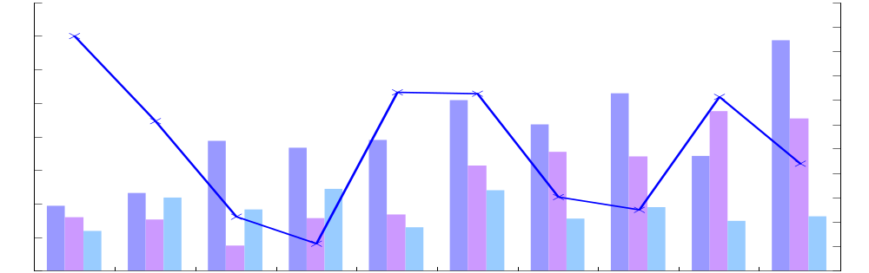

Marketing Expenses
M
Prime Target of Cost Control
Net addition
(Thousand)
(KRW Billion)
160
FNP start
700
140
600
MNP start
500
120
400
100
300
80
200
100
60
0
40
(100)
(200)
20
(300)
0
(400)
Mar_03
Jun_03
Sep_03
Dec_03
Mar_04
Jun_04
Sep_04
Dec_04
Mar_05
Jun_05
Sales promotion
Sales commission
Advertisement
Net addition
(*) Net addition : Total subscribers (Fixed-line, Broadband, PCS resale)

Slide 9

Regulations
R
FTC Fine
Have already reflected and reserved enough in 2005 2Q
One-off item
VoIP Interconnection Settled
Tariff : KRW 45 ~ 49 / 3 min
Network usage charge: KRW 1,500 / user per month
G/W, G/K usage charge: KRW 16.5 / 3 min

Slide 10


Labor Expenses
L
Minimize Long-Term Effect
Labor expenses
(KRW Billion)
1,302
3% Salary Increase
Recurring
54
Special Bonus of 1 month salary
45
One-time payment
1,149
47
60 shares for ESOP
- Using Treasury Stocks
1,156
2004 1H
2005 1H
(*) ESOP : Employment Stock Ownership Plan

Slide 11

2005 2H Target
2
Effective Market Response and Cost Control
Revenue
(KRW Trillion)
Operating Profit
(KRW Trillion)
5.93(E)
5.79
0.85(E)
0.79
2004 2H
2005 2H
2004 2H
2005 2H

Slide 12



Shareholders Return
S
Sustainable Shareholders Return Policy
Dividend per share
(Won / Share)
3,000
3,000
1,000
1,000
5.72
2,000
2,000
860
Interim Dividend
2003
2004
2005
Regular Dividend

